Slide 1
Psychology 201
Chapter one
Ms. Diala Itani

Slide 2
Psychology
What is psychology ?
= scientific study of behavior and mental processes
Why is Psychology a science?
It is based on supported evidence and experimental studies
Use of scientific method: gather and analyze objective information, removing biases and minimizing errors. To get reliable results that can predict future behaviors
Defines clear and concrete terms
Analysis of theories

Slide 3
Goals of Psychology
Describe : identify, classify behaviors and mental processes
Understand: propose reasons for overt observations ( behaviors) and cognitive ( internal work of the mind)
Predict: offer predictions about a given condition
Influence: use results to solve future problems

Slide 4
Areas of psychology
Example: I get a snake class..
Personality psychologist
Why is he afraid and she is not?
Behavioral psychologist:
Individual previous learning behaviors: was she exposed to snakes when she was young and she learned to be scared?
Social psychologist: How other people’s reactions influence our own:
Did he look at the classmates who ran away from the snake and he was influenced by them?

Slide 5
Areas of psychology
Biological psychologist:
Look at the man’s response in terms of heart rate and sweating
Neuroscientist
Areas of the brain that are activated during fear such as the amygdala

Slide 6
Revision of some of the subfields
Clinical :
Assessment and treatment of mental illness, abnormal behavior, psychiatric problems psychological disorders in biological factors
Cognitive: how people think, problem solving, decision making, language, attention information processing model
Experimental: processes of sensing, learning, thinking about the world. Use of research case studies, naturalistic observations

Slide 7
Psychology subfields
Developmental: specialization in infant, child, adolescent adult development of physical , cognitive, emotional aspects.
Forensic: legal issues, studying criminal behavior and treatments, working in the court, interviewing witnesses, conducting evaluations
Counseling: educational , social and career adjustment problems. Also about enhancing well-being, better functioning, goal setting, problems not related to biological deficiencies

Slide 8
Psychological subfields
Health: relationship between psychological factors and physical illness or disease
Personality : patterns of thoughts, feelings, behavior , traits that make each unique
  Social :how people’s thoughts, feelings, and actions are affected by others
Behavioral genetics
  How we might inherit certain behavioral trait
  How the environment influences whether we actually display such traits

Slide 9
The education of a psychologist
PhD : Doctor of philosophy
PsyD : Doctor of psychology
MA or MS Master’s degree
BA or BS Bachelor’s degree
Careers:
Administrator
Serving as a counselor
Providing direct care
Human resource, trainer, customer relation, advertising, marketing ,researcher, health system, career advisor, social worker , program designers ( more examples on p.11)

Slide 10
Some history : origins
Structuralism
  Wilhelm Wundt
  Focuses on uncovering the fundamental mental components of consciousness, thinking, and other kinds of mental states and activities
  Introspection: Procedure used to study the structure of the mind in which subjects are asked to describe in detail what they are experiencing when they are exposed to a stimulus

Slide 11
structuralism
Criticisms of structuralism
  Introspection not a scientific technique
  People had difficulty describing some kinds of inner experiences
These drawbacks led to the development of newer approaches

Slide 12
Functionalism
Functionalism
  William James
  Concentrated on how behavior functions and the role of behavior in allowing people to adapt to their environments

Slide 13
Gestalt
Gestalt psychology
  Focuses on the organization of perception and thinking in a “whole” sense rather than on the individual elements of perception

Slide 14
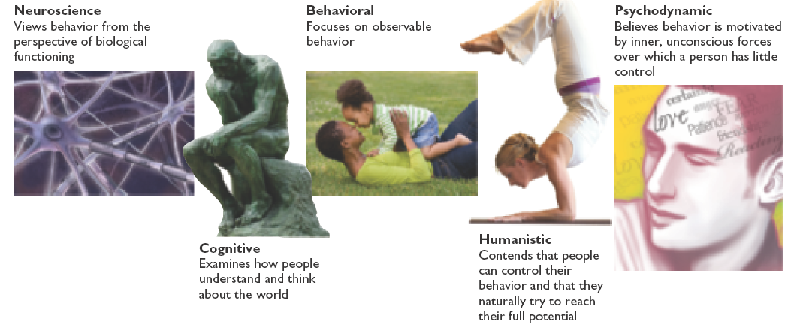
Major perspectives of psychology

Slide 15
Major perspectives
Neuroscience perspective: Views behavior from the perspective of the brain, the nervous system, and other biological functions
  ex: How damage to different parts of the brain affects
  personality, behavior, learning ability, language
Psychodynamic perspective
  Sigmund Freud
  Behavior is motivated by unconscious inner forces over which the individual has little control

Slide 16
Major perspectives
Behavioral perspective
John B. Watson & B. F. Skinner
observable, measurable behavior should be the focus ex How children adopt certain behaviors by imitating their parents (social-learning) or by parents directly rewarding those behaviors (behavioral)
Cognitive perspective: Focuses on how people think, understand, and know about the world
  Information processing:
  - If we believe we will fail, we may not even try
  - we remember what is consistent with our beliefs

Slide 17
Major perspectives
Humanistic perspective
  Carl Rogers and Abraham Maslow
  Suggests that all individuals naturally strive to grow, develop, and be in control of their lives and behavior
emphasizes free will, personal growth, and resilience

Slide 18
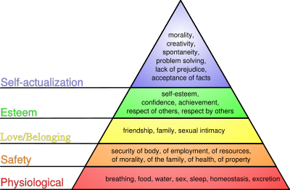
Maslow’s Hierarchy of Needs

Slide 19
Ex: Depression & different perspectives
Biological/neuro: abnormalities in neurotransmitters in the brain
Behavioral: depressive symptoms have been reinforced (rewarded) by the environment (e.g., getting to stay home from school because of feeling depressed)
Cognitive: negative, pessimistic thinking style
Psychodynamic: depression is due to unconsciously displacing anger towards your parent onto yourself
Humanistic: depression is due to being unauthentic or by being otherwise blocked in fulfilling your potential

Slide 20
Key issues
Table in the book

Slide 21
Scientific Method
Approach through which psychologists systematically acquire knowledge and understanding about behavior and other phenomena of interest

Slide 22
What’s the difference…
Experimental and non-experimental research are distinguished by the degree of control that the researcher has over the subjects and conditions in the study.
In non-experimental research, there is often careful observation and measurement, but in experimental research there is also random assignment and manipulation of a variable.
The increased control in experimental research allows you to infer causal relationships between variables.

Slide 23
Non-Experimental Research: Methods for Gathering Information
Case Studies
Observational Studies*
  Naturalistic
  Laboratory
Surveys
Correlation = strength of a relationship between two variables
  Positive vs. Negative Correlations = nature of relationship
  Coefficient of Correlation = strength of relationship
CORRELATION DOES NOT EQUAL CAUSATION

Slide 24
Experimental Research
In experimental research, you manipulate one or more (independent) variables and observe the effect of this manipulation on one or more other (dependent) variables, while controlling for the influence of other (extraneous) variables.
In this way, you can conclude that it was the effect of your independent variable that CAUSED the observed change in your dependent variable.

Slide 25
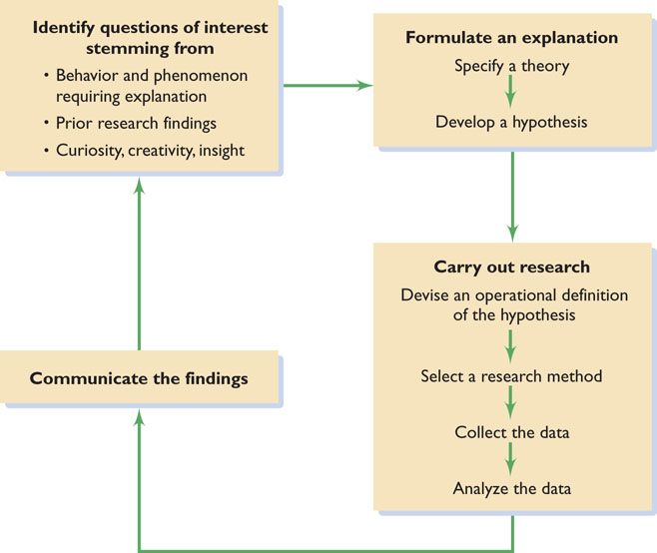
The scientific method

Slide 26
What is a theory ?
Broad explanations and predictions concerning phenomena of interest
Example:
Diffusion of responsibility - Greater the number of bystanders in an emergency situation, the smaller the share of the responsibility each person feels

Slide 27
Hypotheses: Crafting Testable Predictions
Hypothesis: A prediction, stemming from a theory, stated in a way that allows it to be tested
Psychologists rely on formal theories and hypotheses for many reasons:
  Permits them to place bits of observations within a coherent framework
  Help psychologists to make deductions about unexplained phenomena
  Develop ideas for future investigation
Operational definition: Translation of a hypothesis into specific, testable procedures

Slide 28
What does “Research” mean?
Systematic inquiry aimed at the discovery of new knowledge
Key to understanding the accuracy of hypotheses and theories
Descriptive research
  Systematic investigation of a person, group, or pattern of behavior

Slide 29
Archival Research
Existing data is used to investigate a hypothesis:
  Census documents
  College records
  Newspaper clippings
Problem with using existing data:
  Data may not be in a form that allows the researcher to test a hypothesis fully

Slide 30
Naturalistic Observation
Investigator simply observes some naturally occurring behavior
  Does not make a change in the situation
Advantage - Sample of what people do in their natural habitat
Disadvantage - Inability to control any of the factors of interest

Slide 31
Survey Research
People are asked a series of questions about their behavior, thoughts, or attitudes
Pitfalls
  Results will be inconsequential if the sample is not representative
  Survey respondents may not want to admit to holding socially undesirable attitudes
http://testyourself.psychtests.com/bin/transferreq=MnwyMTE0fDM2Mzk1ODR8MXwx&refempt=
http://testyourself.psychtests.com

Slide 32
Correlational Research
Research in which the relationship between two sets of variables is examined to determine:
  Whether they are associated, or “correlated”
Correlation coefficient
  Positive - As the value of one variable increases, so will the value of the other variable
  Negative - As the value of one variable increases, value of the other variable will decrease
disadvantage - Inability to demonstrate cause-and-effect relationships

Slide 33
Experimental research
Experiment: Investigation of the relationship between two (or more) variables by:
  Producing a change in one variable in a situation and observing the effects on the second variable

Slide 34
Experimental Research
Experimental groups and control groups
  Treatment
    Manipulation implemented by the experimenter
  Experimental group
    Any group participating in an experiment that receives a treatment
  Control group
    Group participating in an experiment that receives no treatment

Slide 35
Experimental Research
Random assignment to condition: Participants are assigned to different experimental groups or “conditions” on the basis of chance
Significant outcome: Meaningful results
  Make it possible for researchers to feel confident that they have confirmed their hypotheses
Replicated research: Research that is repeated

Slide 36
The Ethics of Research
Informed consent: A document signed by participants:
  Affirms that they have been told about the basic outlines of the study

Slide 37
Should Animals Be Used in Research
Procedures that subject animals to distress are permitted:
  When an alternative procedure is unavailable
  When the research is justified by its prospective value
Provides greater experimental control over nonhumans
Procedures that might not be possible with people can be carried out

Slide 38
Threats to Experimental Validity: Avoiding Experimental Bias
Experimental bias: Factors that distort the way the independent variable affects the dependent variable
  Experimenter expectations
  Participant expectations

Slide 39
Threats to Experimental Validity: Avoiding Experimental Bias
Placebo: A false treatment without any significant chemical properties
Double-blind procedure - Keeping experimenter and participant “blind” to the nature of the drug administered

Slide 40
Don’t forget..
Read the recap/evaluate/rethink pages
Read the main definitions & tables
Remember what we focused on..
Enjoy ☺

